Slide 1
Data Representation

Slide 2
Index
Number Systems
Decimal Numbers
Binary Numbers
Decimal to binary conversion
Hexadecimal Numbers
Data Units and Scaling
Bytes, nibble and words
Kilo, Mega and Giga
Arithmetic with Binary Numbers
Binary addition
Sign/magnitude numbers
Two’s complement format
Multiplication
Fractional Numbers
Fixed-Point Number Systems
Floating-Point Number Systems

Slide 3
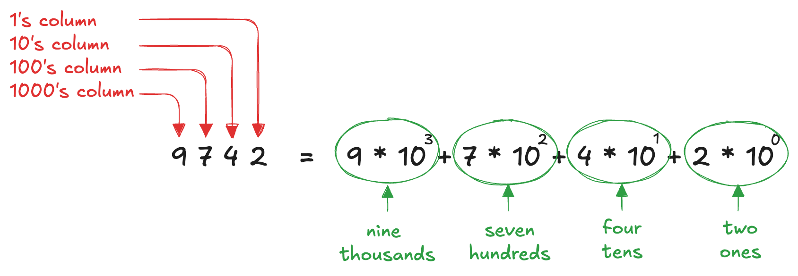
Decimal Numbers
In elementary school, we learned to do arithmetic in decimal
just as we have ten fingers, there are ten digits: 0, 1, 2, …, 9
Decimal digits are joined together to form longer numbers
each column has ten times the weight of the previous column
from right to left, the column weights are 1, 10, 100, 1000, and so on
Decimal numbers are referred to as base 10
An N-digit decimal number represents one of 10^{N} possibilities
range of the number
a three-digit number represents one of 1000 possibilities in the range 0 to 999

Slide 4
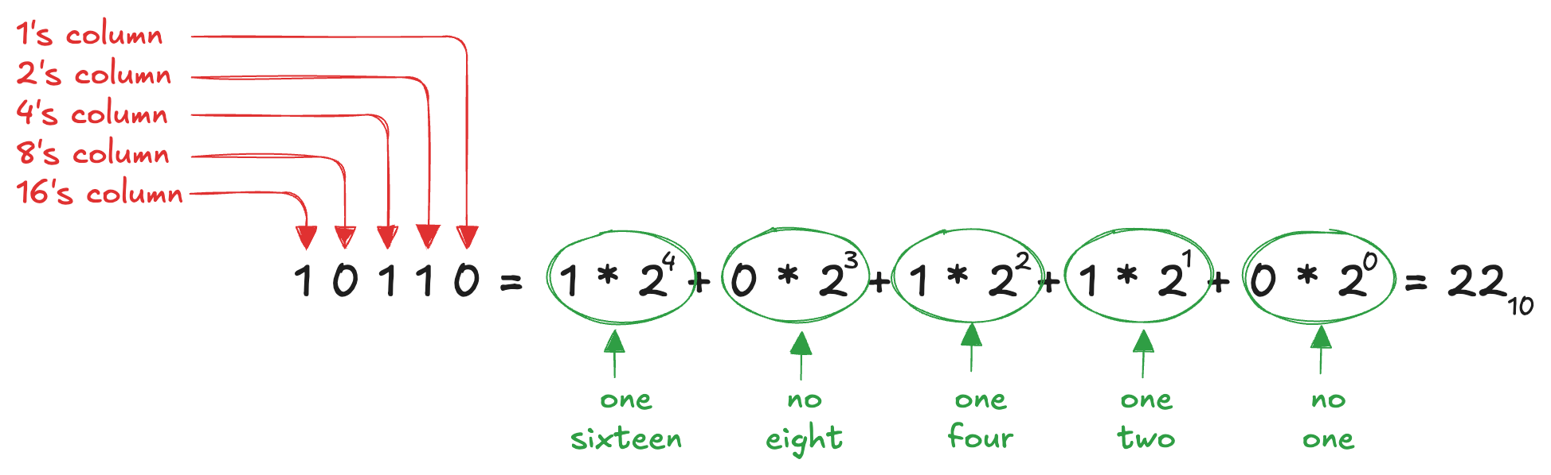
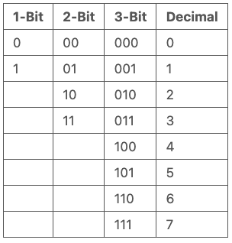
Binary Numbers
Bits are joined together to form binary numbers
a column of a binary number has twice the weight of the previous column (base 2)
1, 2, 4, 8, 16, 32, 64, 128, 256, 512, 1.024, 2.048, 4.096, 8.192, 16.384, 32.768, 65.536
An N-bit number represents one of 2^{N} possibilities

Slide 5
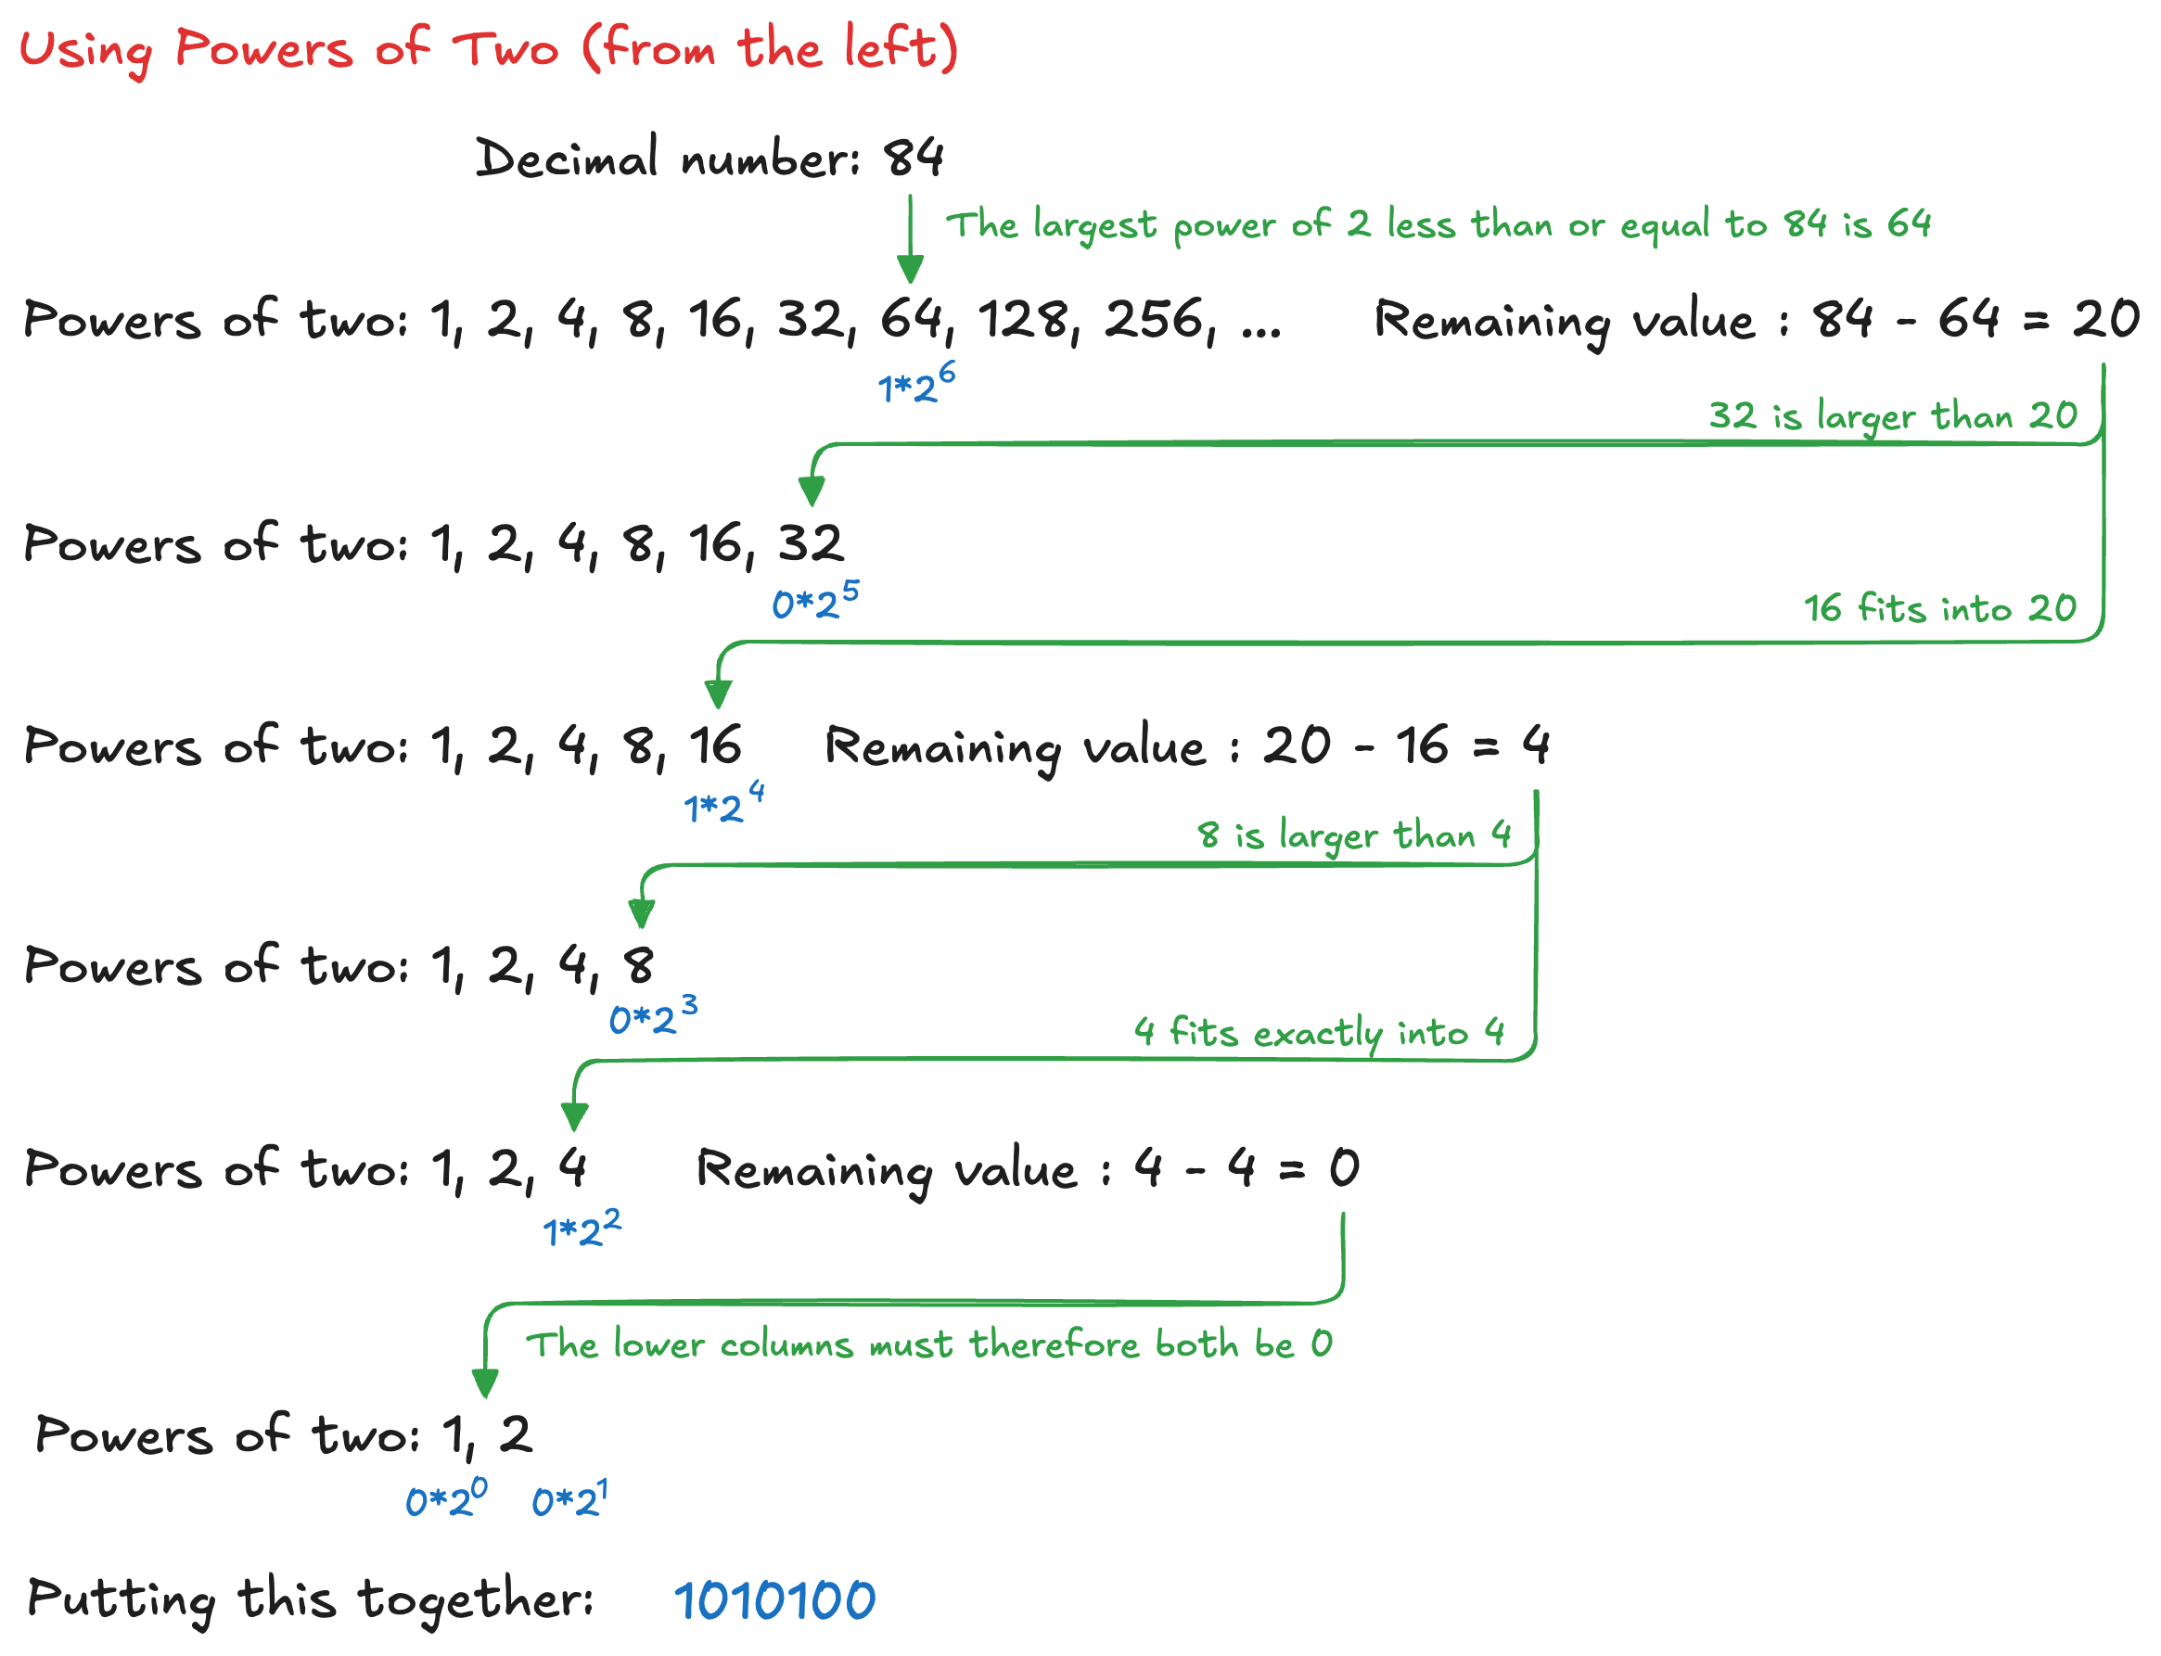
Decimal to binary conversion (1)

Slide 6
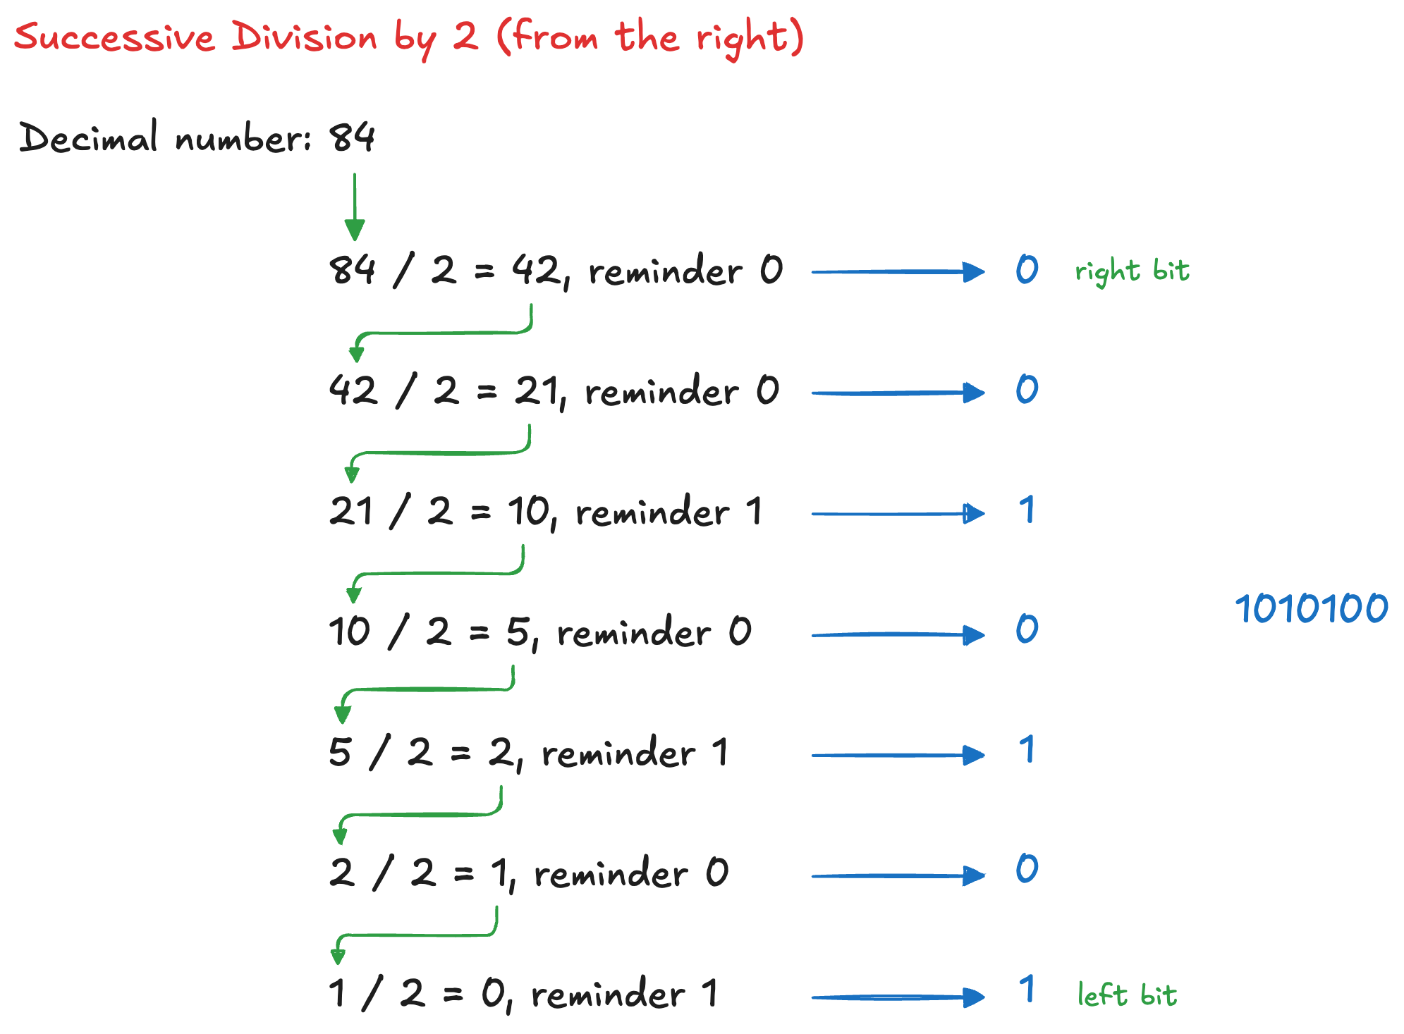
Decimal to binary conversion (2)

Slide 7
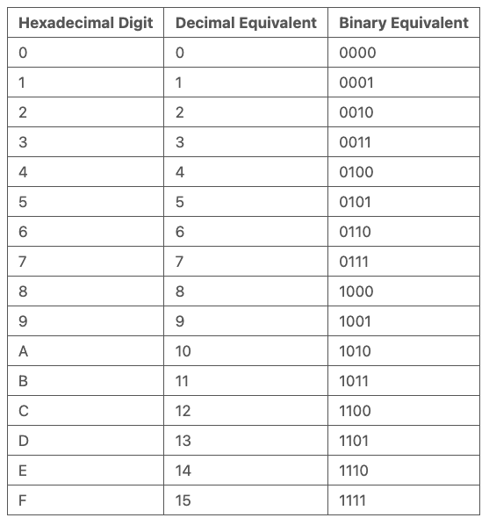
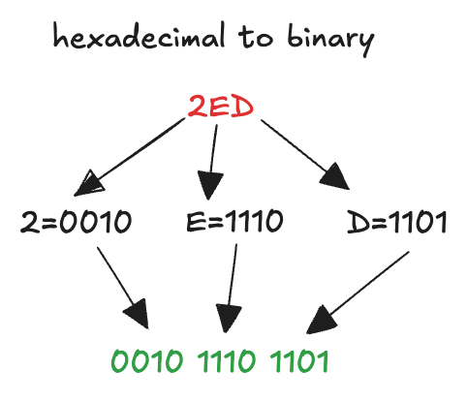
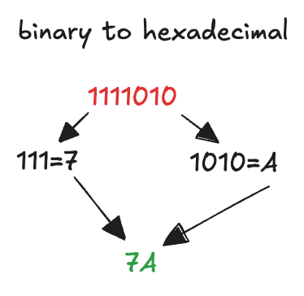
Hexadecimal Numbers
Writing long binary numbers becomes tedious and prone to error
Notice: a group of four bits represents one of 2⁴ = 16 possibilities
it is convenient to work in base 16
digits 0 to 9 along with the letters A to F
Each hexadecimal digit directly corresponds to four binary digits

Slide 8
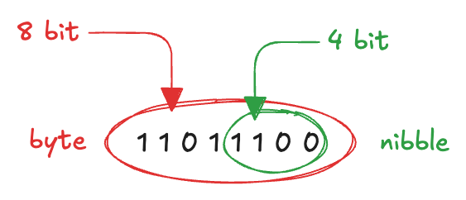
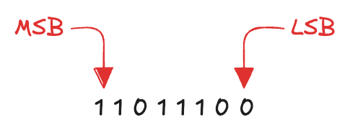
Bytes, nibble and words
A group of eight bits is called byte
it represents one of 2⁸ = 256 possibilities
size of objects stored in memories is measured in bytes
A group of four bits is called nibble
it represents one of 2⁴ = 16 possibilities
a hexadecimal digit stores one nibble
Microprocessors handle data in chunks called words
the size of a word depends on the architecture of the microprocessor
most computers had 64-bit processors (64-bit words)
older computers handling 32-bit words were also widely available
Within a group of bits…
…the bit in the first column (on the right) is called the least significant bit (lsb)
…the bit at the other end (on the left) is called the most significant bit (msb),
Similarly, within a word:
least significant byte (LSB)
most significant byte (MSB)

Slide 9
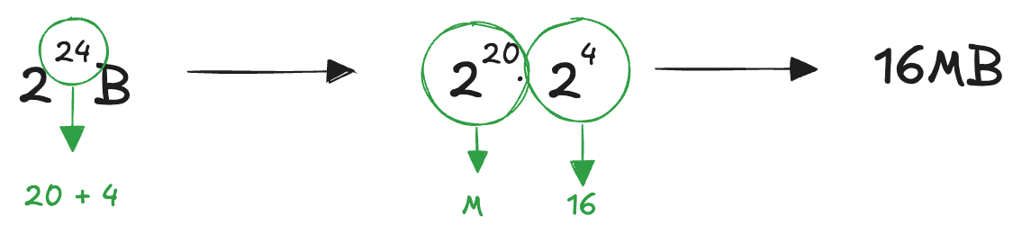
Kilo, Mega and Giga
The powers of two line up nicely with powers of ten: 2¹⁰ = 1024 ≈ 10³
kilo indicates 2¹⁰ ≈ 10³
mega (million) indicates 2²⁰ ≈ 10⁶
giga (billion) indicates 2³⁰ ≈ 10⁹
IEC (International Electrotechnical Commission) makes a distinction
kibibyte (KiB = 1024 B), mebibyte (MiB = 1024^2 B), Gibibyte (GiB = 1024^3 B)
kilobyte (KB = 1000 B), megabyte (MB = 1000^2), gigabyte (GB = 1000^3)
However, in common usage KB, MB, and GB are still often used with base 2
Using these approximation, it is easy to estimate any power of two
remember this: 1, 2, 4, 8, 16, 32, 64, 128, 256, 512
split the exponent into a multiple of ten and the remainder

Slide 10
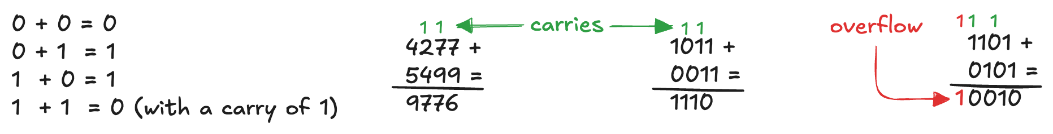
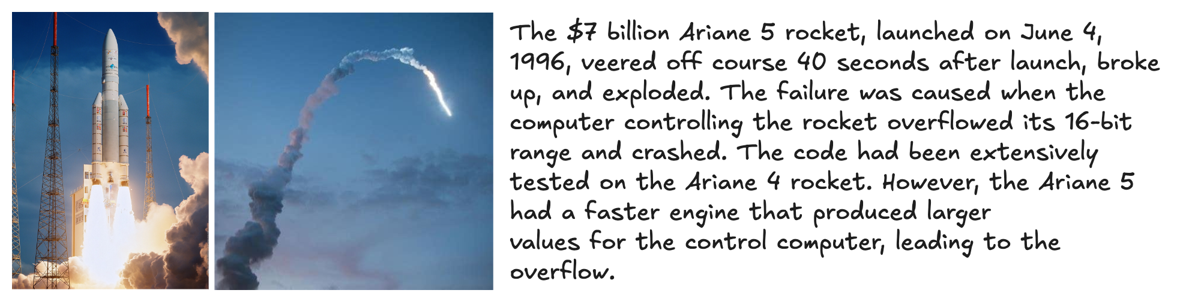
Binary Addition
Like decimal addition, but easier
if the sum of two numbers is greater than what fits in a single digit (1)
we carry a 1 into the next column (carry bit)
We are no in the purely mathematical realm
we are dealing with real systems
we operate on a fixed number of digits, so additions can overflow
if the result is too big to fit in the available digits
Overflow can be detected: check for a carry out of the MSB

Slide 11
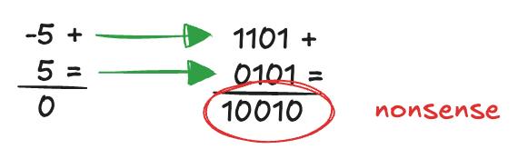
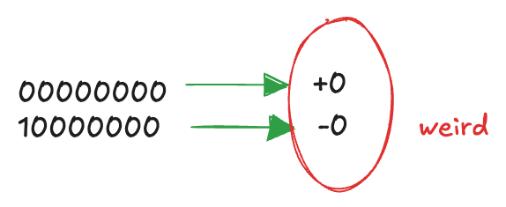
Sign/magnitude Numbers
Binary subtraction
mathematically simple, like addition
in hardware, supporting both would require two circuits (adder + subtractor)
subtraction can be rewritten as addition with a negative number: A – B = A + (-B)
this can reduce both to one operation: addition
requires a representation for negative numbers
Sign/magnitude
use the MSB as the sign and the remaining N−1 bits as the magnitude
a sign bit of 0 indicates positive, a sign bit of 1 indicates negative
intuitively appealing: match our way of writing negative numbers with a minus sign followed by the magnitude
problems:
ordinary binary addition does not work
it is odd that both +0 and −0 exist, both indicate zero

Slide 12
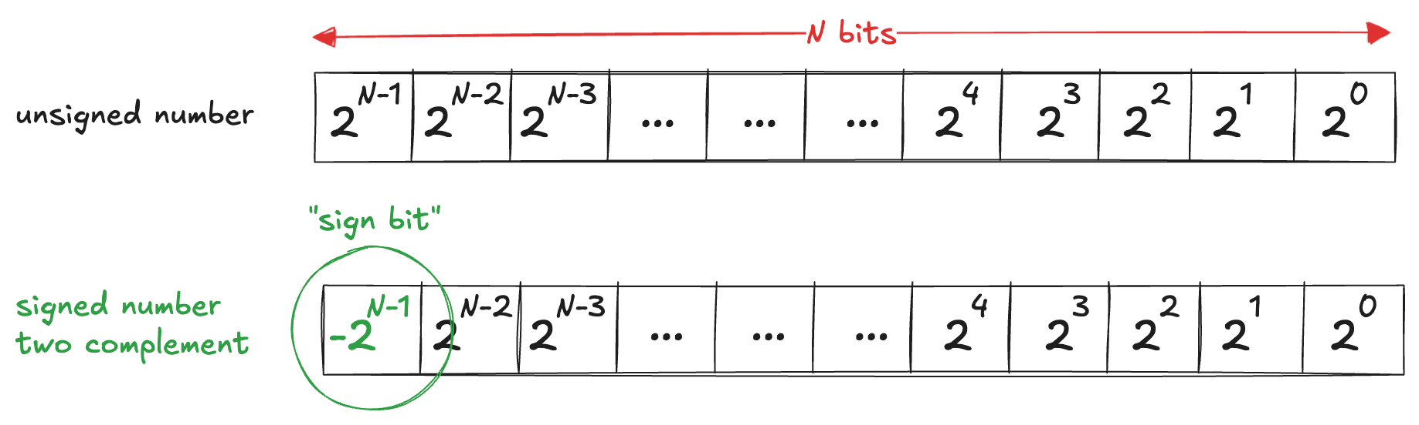
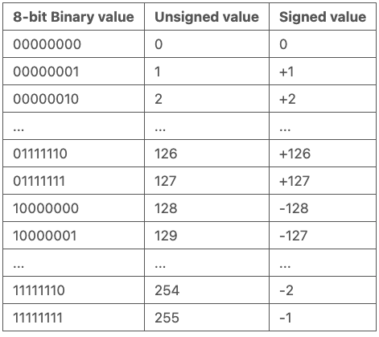
Two’s complement representation (1)
Two’s complement representation
exactly unsigned numbers, except that the MSB has a negative weight
Notice that the most significant bit can be viewed as the sign bit

Slide 13
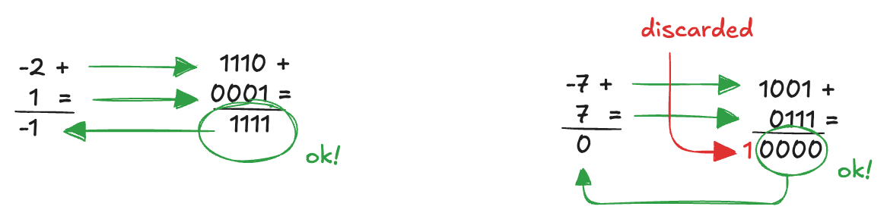
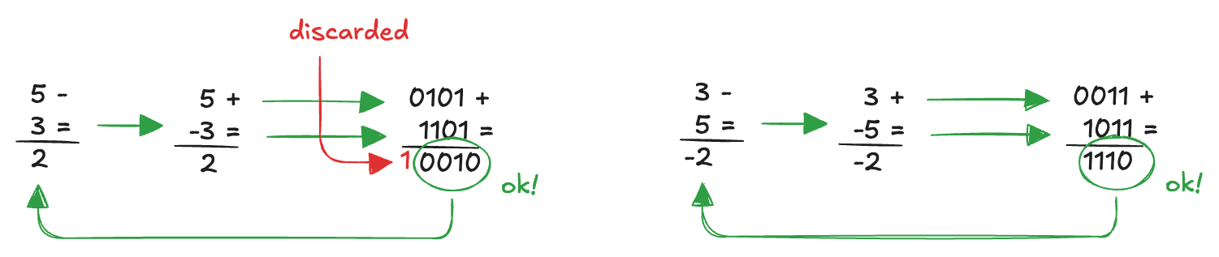
Two’s complement representation (2)
Addition works properly for both positive and negative numbers
when adding N-bit numbers, the carry of the Nth bit is discarded
Subtraction is performed as A-B = A + (-B)
Zero has only one representation (avoiding the redundancy)
The range of an N-bit two’s complement number spans [−2^{N−1}, 2^{N−1} − 1]
there is one more negative number than positive number (because there is no −0)
it is called the weird number (it has no positive counterpart)

Slide 14
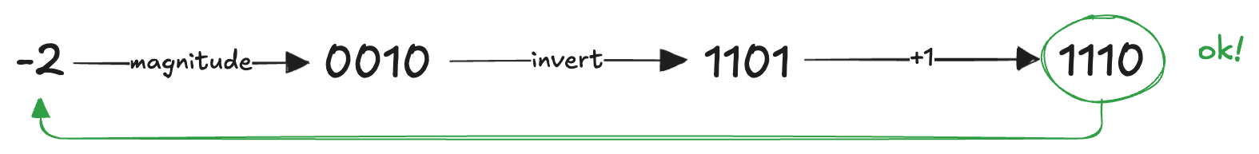
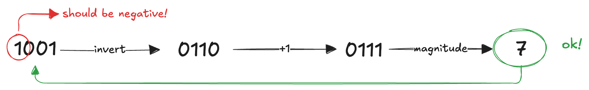
Two’s complement representation (3)
Procedure to obtain the two’s complement representation of a negative number :
take the binary representation of the positive number (the magnitude)
invert all the bits (this is called the one’s complement)
add 1 to the result
We can reverse the procedure to get the magnitude of a negative number

Slide 15
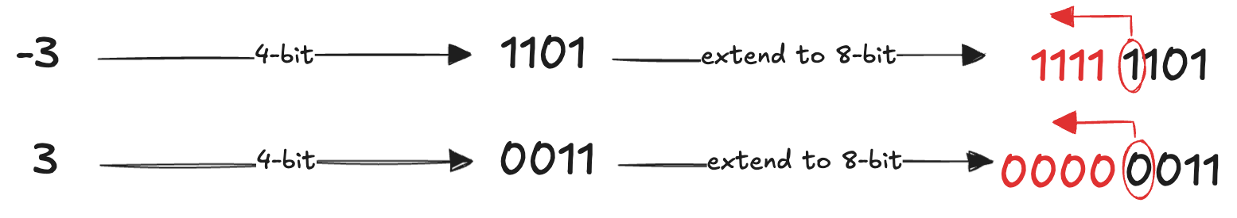
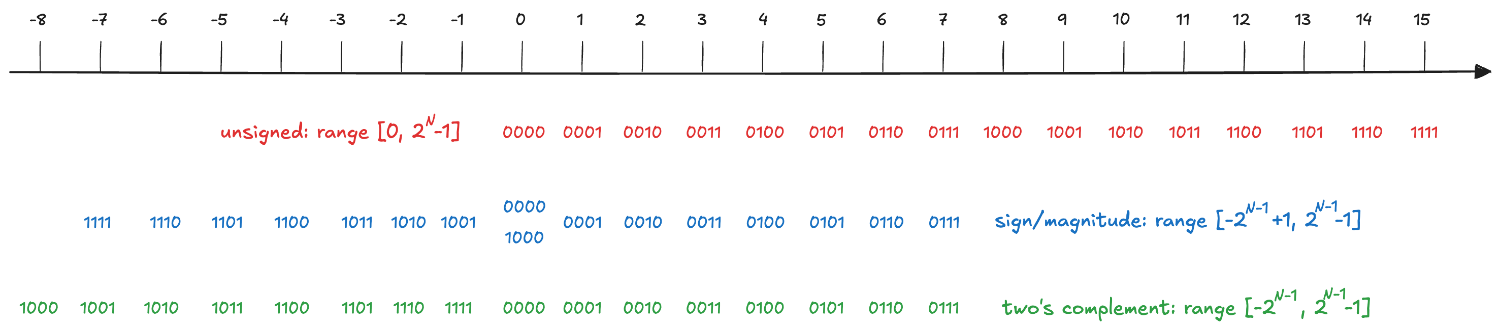
Two’s complement representation (4)
When a two’s complement number is extended to more bits, the sign bit must be copied into the most significant bit positions (sign extension)
Comparison:

Slide 16
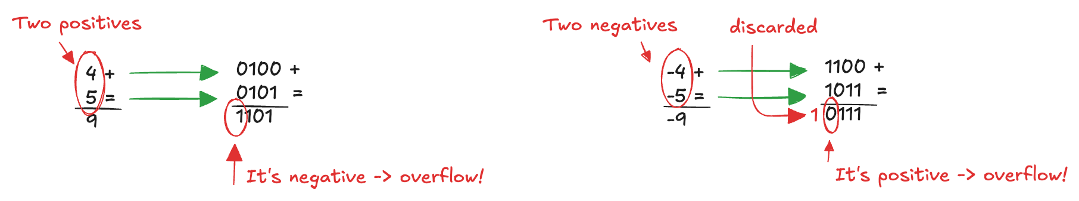
Detecting Overflow in Signed Addition
Cannot detect overflow by just checking the final carry (unlike unsigned).
Overflow happens only when adding two numbers with the same sign.
Rule of thumb:
positive + negative or negative + positive -> no overflow
positive + positive -> must stay positive
negative + negative -> must stay negative
if the result flips sign, the true value exceeded the representable range -> overflow

Slide 17
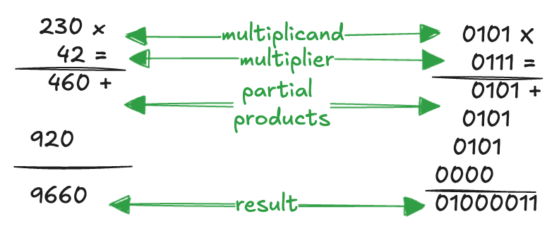
Multiplication
Multiplication of unsigned binary numbers is like decimal multiplication but involves only 1 and 0
partial products are formed by multiplying a single digit of the multiplier with the entire multiplicand
the shifted partial products are summed to form the result
The result of multiplying an M-bit number by an N-bit number may require up to M+N bits
Partial products in the binary case are either the multiplicand or all 0

Slide 18
Fractional Numbers
Computers operate on both integers and fractions
we have only considered representing signed or unsigned integers
fixed- and floating-point number systems that can represent rational numbers
Fixed-point numbers are analogous to decimals
some of the bits represent the integer part, and the rest represent the fraction
Floating-point numbers are analogous to scientific notation
with a mantissa and an exponent

Slide 19
Fixed-Point Number Systems (1)
It has an implied binary point between the integer and fraction bits
analogous to the point between the integer and fraction digits of a decimal number
0110.1100 = 2²+2¹+2⁻¹+2⁻² = 6.75
Signed fixed-point numbers can use either
sign/magnitude notation: the most significant bit is used to indicate the sign
-2.375 = 1010.0110
two’s complement:
-2.375 = 1101.1010
Even though any integer number can be written as a sum of powers of two:
$78 = 64 + 8 + 4 + 2 = 2^6 + 2^3 + 2^2 + 2^1$
Decimal fractions are rarely exact in binary:
0.78 = 0.11000100100001111110…
infinite repeating expansion in base 2
just like 1/3 = 0.3333…in base 10.
Only fractions of the form k/2^n can be represented exactly in binary

Slide 20
Fixed-Point Number Systems (2)
Notice that fixed-point numbers are just a collection of bits
there is no way of knowing the existence of the binary point
only through agreement of those people interpreting the number
Standard formats
Ua.b unsigned fixed-point number with a integer bits and b fraction bits
Qa.b signed (two’s complement) fixed-point number with a integer bits b fractional bits
Commonly used in digital signal processing (DSP), graphics, and machine learning applications
Q1.15 is the most common
Q1.31 sometimes used for higher precision intermediate results
U8.8 sometimes used for sensor readings

Slide 21
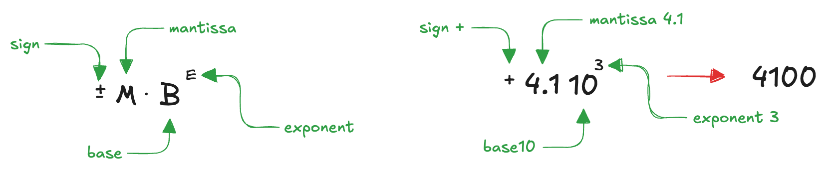
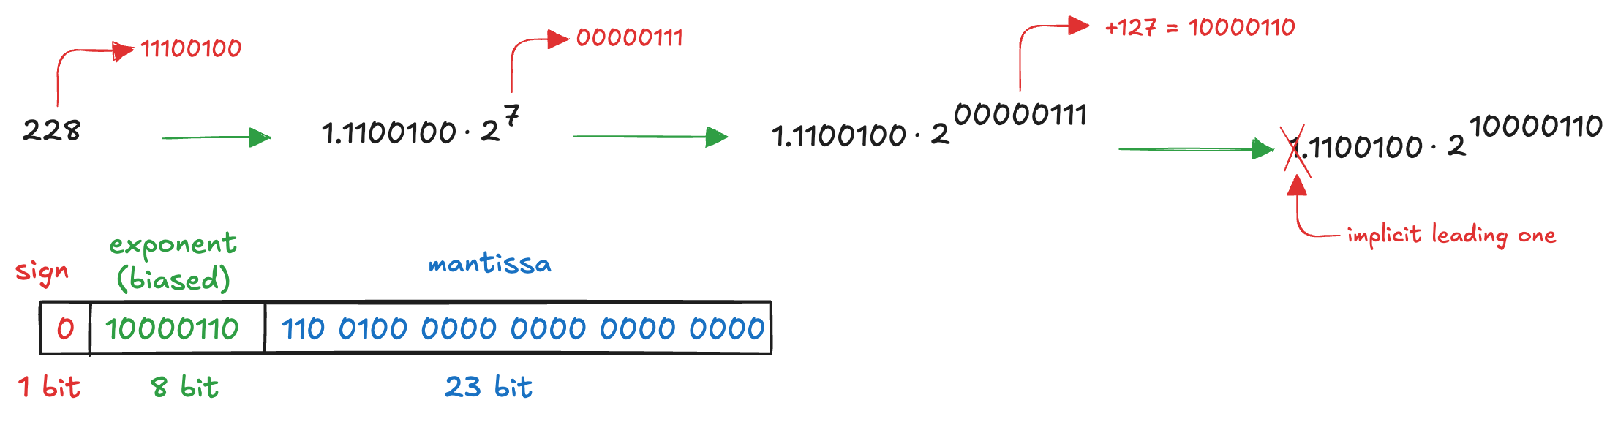
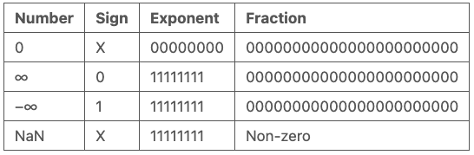
Floating-Point Number Systems (1)
Analogous to scientific notation:
the decimal point “floats" to the position right after the most significant digit
allow the representation of very large and very small numbers
Historically, many incompatible formats -> poor portability
IEEE 754 (1985) introduced a universal standard: 32-bit single precision
Special cases:

Slide 22
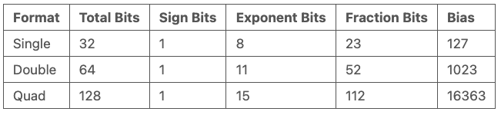
Floating-Point Number Systems (2)
So far, we have examined 32-bit floating-point numbers
single-precision (float)
The IEEE 754 standard also defines other types
Today, growing importance of machine learning, new formats are emerging:
Google BFloat16 (exponent: 8 bits, mantissa: 8 bits)
IMB DLFloat16 (exponent: 6 bits, mantissa: 10 bits)
NVIDIA FP8 (exponent: 4 bits, mantissa: 4 bits)
Tesla CFloat8 (exponent: 5 bits, mantissa: 4 bits)
NVIDIA FP4 (introduced in GPU Blackwell in 2024)

Slide 23
There are 10 kinds of people in this world: those who can count in binary and those who can’t

